Slide 1
ELL 205 Project
Image Smoothening
using Histogram
Presented by:
Rajat Mahaur (2020CS50534)
Richa Yadav (2020CS50438)
Manshi Sagar (2020CS50429)

Slide 2
Overview
We aim to transform a source image into a smoothened image by processing its histogram.
The method used for smoothening is Histogram equalization.
To improve the image further, we apply mean filtering to the smoothened image.

Slide 3

Introduction
Histogram
Histogram is a graphical representation of the intensity distribution of an image. In simple terms, it is a graph of the number of pixels for each intensity value (gray-scale).
Image Smoothing Image smoothing is the process of reducing noise from the source image to obtain an image with a blended effect. Smoothing can be done by applying mean or median functions on a group of pixels.
Histogram Equalization Histogram equalization is a method in image processing used to improve the contrast of an image.

Slide 4

We aim to create an image that is “more distributed” over the intensity values . This is accomplished by effectively spreading out the intensity values, i.e. stretching out the intensity range of the image.
Why do we need image smoothing?
This is useful for images which are washed out, i.e., the light and dark areas are blended together, which creates an image with good contrast , highlights and shadows.
This is used to remove noise from images. In images, the discontinuities in intensity values of some pixels is some kind of noise.
Note
Histogram equalization need not always work
We will get there shortly!
Histogram equalization serves the exact purpose.

Slide 5
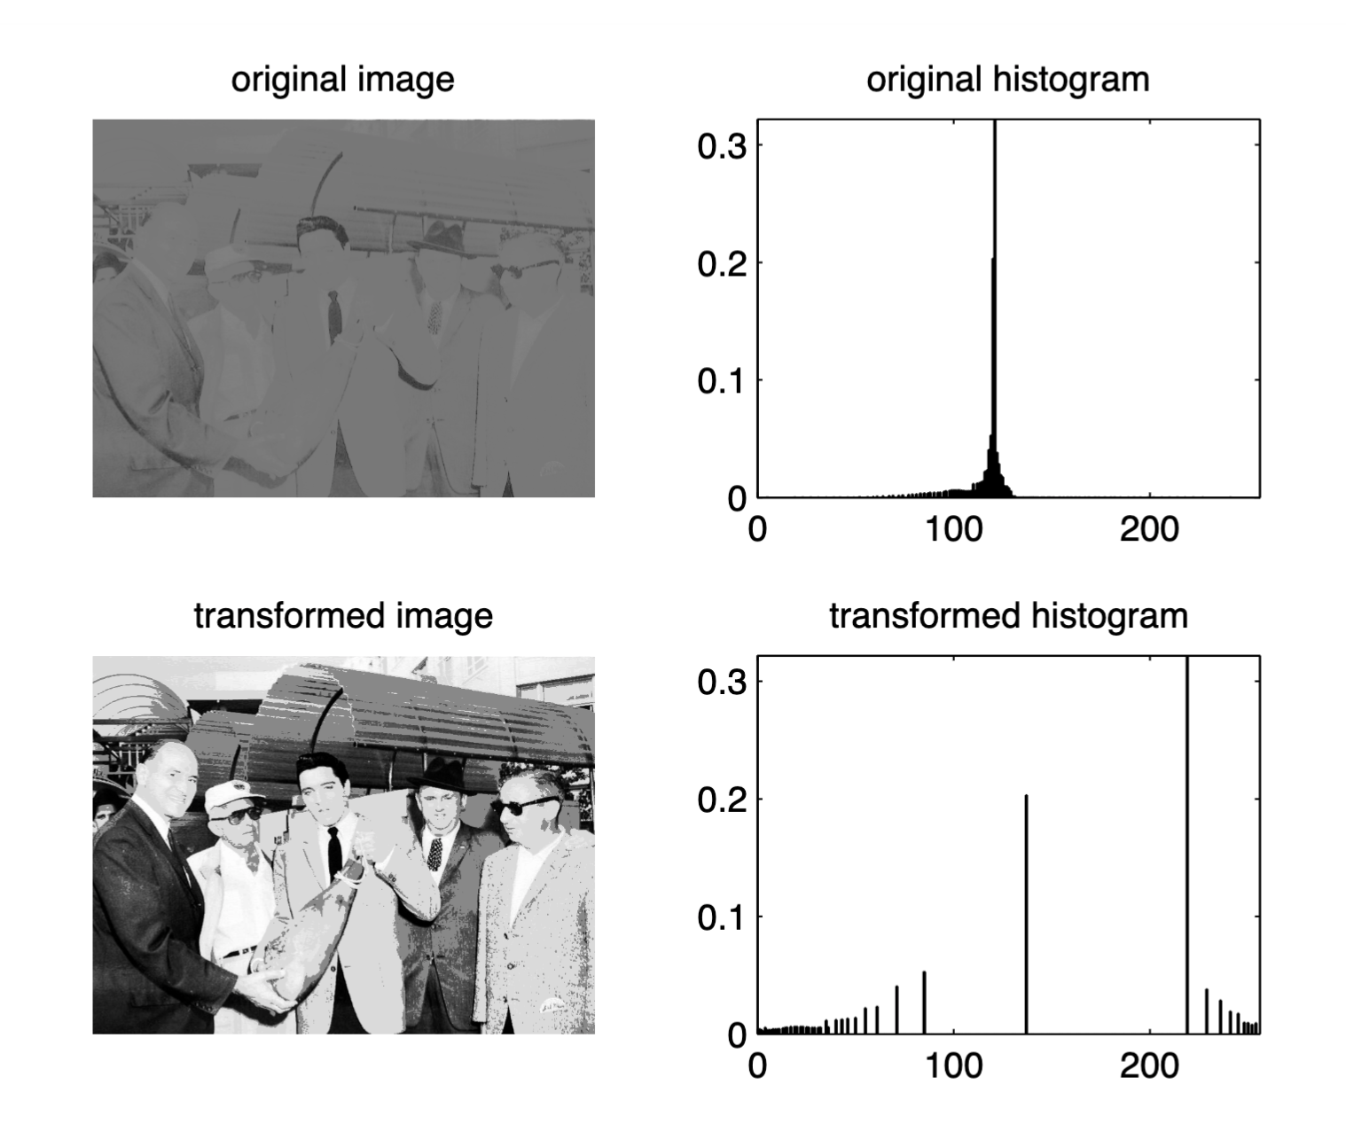
How to achieve this?
Histogram was already recording the number of pixels against the intensity values, we have to now “expand” these numbers over the intensity values for contrasting so as spread the intensity range.
In spreading the intensity range it also removes the pixels having the discontinuity in intensity values.

Slide 6
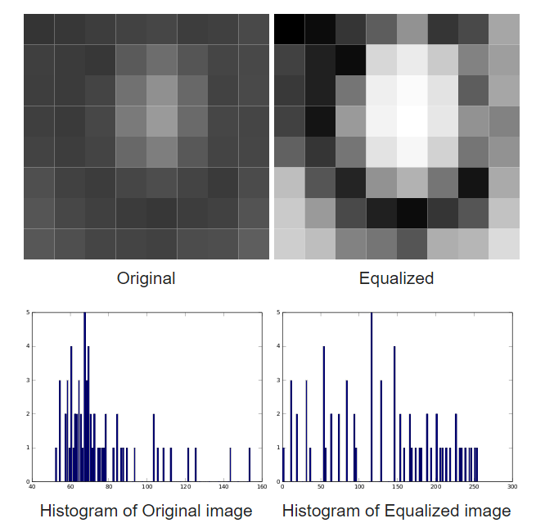
Pictorial Representation
We are trying to uniformly distribute the given histogram of a image,
We want to map the intensity values in our histogram to values of more diversified intensities.
What mathematical tool to use?
It’s the probability and then convolution!
We will take out a function which will be applied to the histogram so that the data of histogram will be more uniformly distributed.
“MAP”, it changes the PDF of a given image into that of a uniform PDF that spreads out from the lowest pixel value (0 in this case) to the highest pixel value (L – 1)

Slide 7
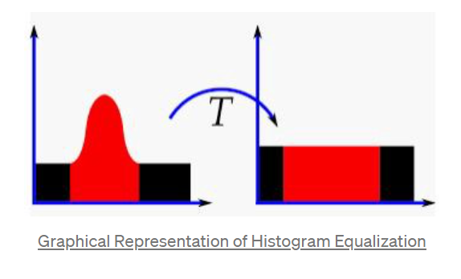
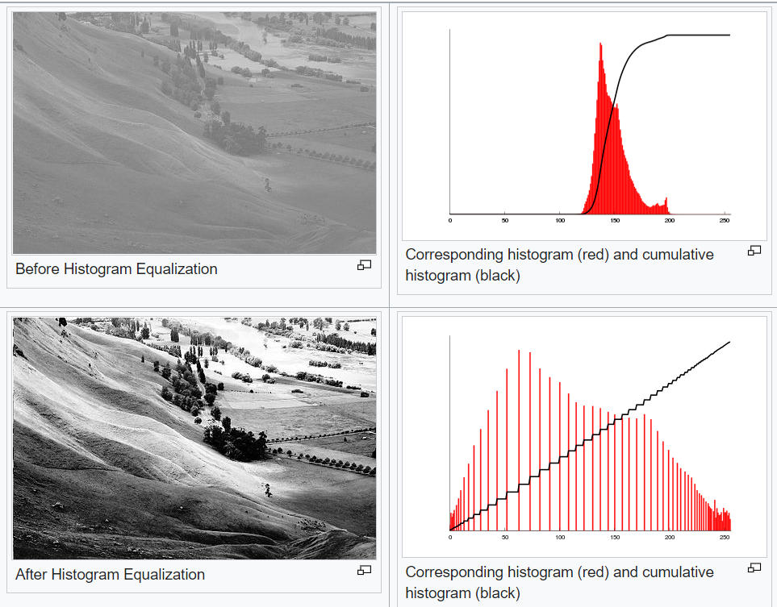
Mathematical approach
If we consider the histogram of our source image as a Random Variable(X), X(i) represents the number of pixels having intensity i.
The PDF of our source image is not uniformly distributed and hence the CDF is not linear, which makes the image noisy.
As the CDF becomes closer to linear, the image becomes smoother.
We do a mapping from X to a new Random Variable (Y) such that the PDF of Y is uniformly distributed, and CDF is linear. The image corresponding to Y will be more contrasted and smoother than image corresponding to X.
We can try to further improve the image by median, mean or gaussian smoothing.

Slide 8
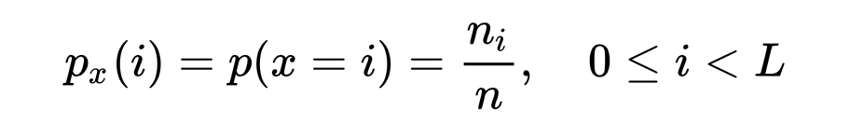
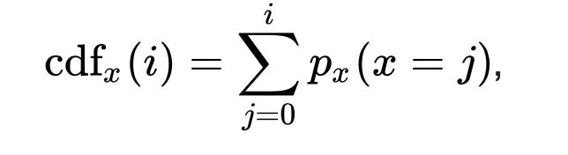
Here p_{x} is the PDF of Random Variable X (source image) and
n_{i} is the number of pixels having intensity i
The CDF of X is:

Slide 9
Y is the random variable corresponding to the image obtained after histogram equalization. Let M be the mapping function from X to Y
then,
Y = M(X)
The output image should have a linearised CDF.

Slide 10
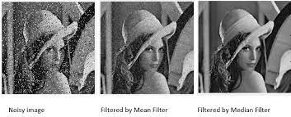
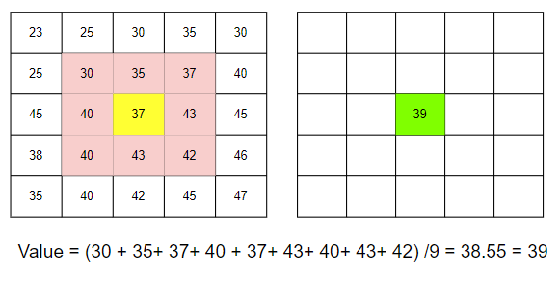
Mean filtering
This is under spatial filtering.
This uses the basic concept of Convolution that is shift , multiply and add.
We use a kernel (3x3) which moves over the pixels of the image, analogy to pixels as the function x(t) and the kernel as the impulse response h(t), we add these values after multiplication and divide by their mean and put that in the final output image. Basically the matrix is convolved.
y(t) = x(t)*h(t)
This method creates a blurring effect.
Tip
We can also use the GAUSSIAN and MEDIAN filtering instead, for better results.

Slide 11
Does it always work?
Big fat no!
It can produce undesirable effects.
Basically this method works for the 2-D images , i.e., images in gray scale. Color images are 3-D ,i.e., in addition to the row and column they also have a third dimension of RGB color. Thus in case we apply this to individual colour then this might create dramatic changes in color scheme of the image.
Histogram equalization may fail for images that have darker background and lighter foreground. In this case, the gray scale of background and foreground gets mixed up, which does not preserve edges and thus creating a washed out image which is not desirable!

Slide 12
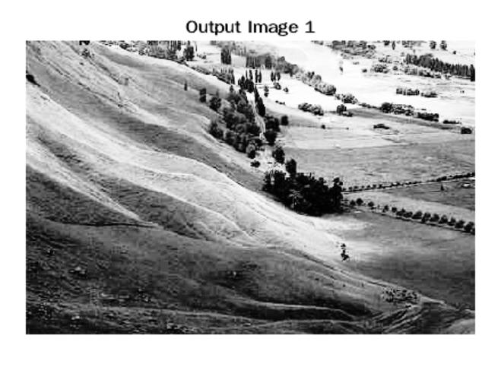
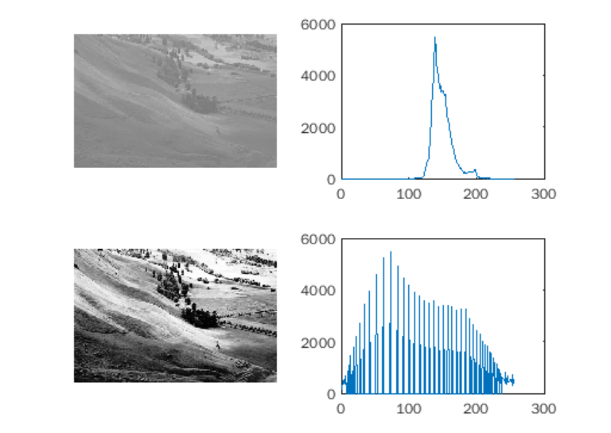
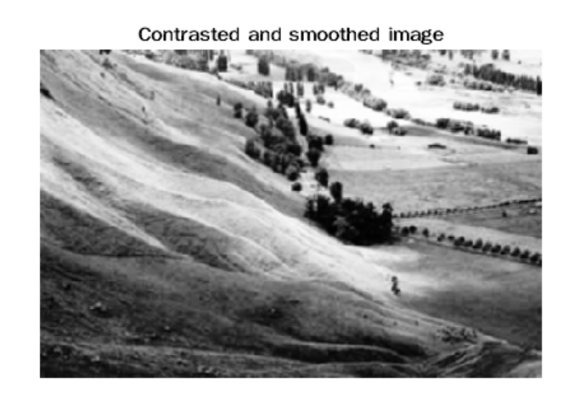
Results from code!
This is histogram equalized image
Before histogram equalization
After histogram equalization
After mean filtering

Slide 13
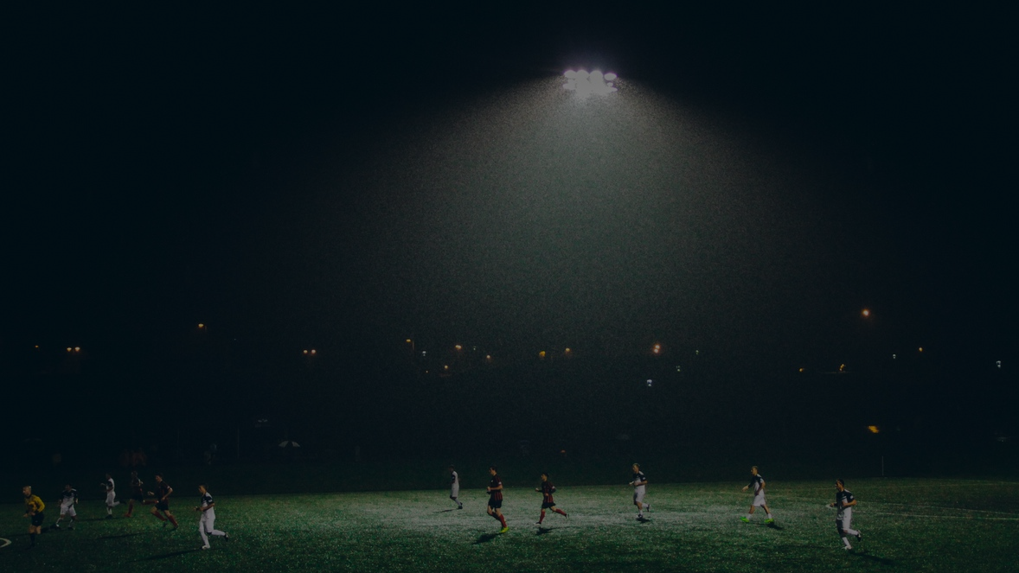
Thank You Everyone!!
Welcome to your questions!!

